Slide 1
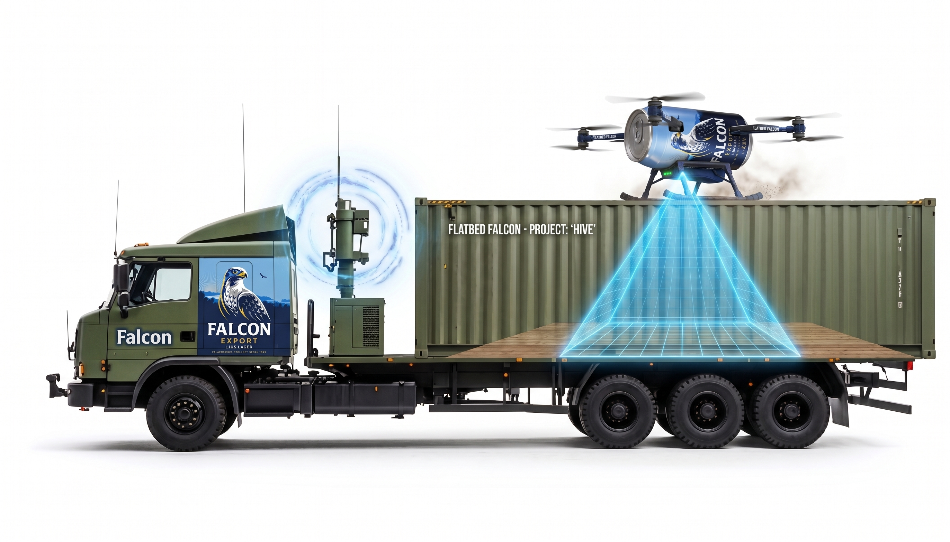
Flatbed Falcon
AUTONOMOUS VEHICLES · PROJECT
A drone that lands on a moving truck. Both drive themselves.
[Team names] · [Date]
Notes:
~20 s. Hi, we are [names]. Our project is Flatbed Falcon: a PX4 drone that autonomously tracks and lands on the flatbed of a pickup truck, while the truck itself drives autonomously around a forest road. Everything runs in Gazebo with ROS 2.

Slide 2



Land a drone on a truck that never stops
THE IDEA
Why
Two agents
Why it's hard
A truck can carry and recharge a drone. Delivery, inspection and search drones could return to it without the truck stopping.
Truck and drone are separate autonomous vehicles. They share state only over ROS 2 topics, like a radio link.
A moving target, curves, link delay, and short straight windows where landing is safe.
Flatbed Falcon · 2
Notes:
~40 s. Why this problem: a truck that carries a drone extends its range, and the drone can land and recharge without the truck stopping. We set it up as two independent agents that only talk over ROS 2 topics, the way two real vehicles would over a radio. What makes it hard is that the target moves and turns, the information arrives late, and you only have a short straight stretch to land on.

Slide 3


Two agents, connected only by topics
SYSTEM OVERVIEW
Truck agent
/truck/odom
Drone agent
road_centerline.csv
1 point per meter
target_tracker
ENU → NED, filter, prediction
/truck/status
truck_driver
Pure Pursuit + speed profile
landing_controller
state machine + tracking
Gazebo Ackermann plugin
/truck/cmd_vel
PX4 Offboard (x500)
/fmu/in/*
/falcon/request
Flatbed Falcon · 3 · ROS 2 Jazzy · PX4 · Gazebo · a logger node records every topic to CSV
Notes:
~50 s. The architecture. On the left the truck: it reads the road centerline, runs Pure Pursuit with a speed profile, and sends velocity commands to Gazebo's Ackermann steering plugin. On the right the drone: target_tracker converts the truck's pose from the world ENU frame into PX4's local NED frame, and landing_controller runs the state machine and sends setpoints to PX4 in Offboard mode. The only things crossing the middle are topics: the truck's odometry and status, and the drone's landing request. All frame conversions live in one file, frames.py, which saved us from a lot of sign bugs.

Slide 4
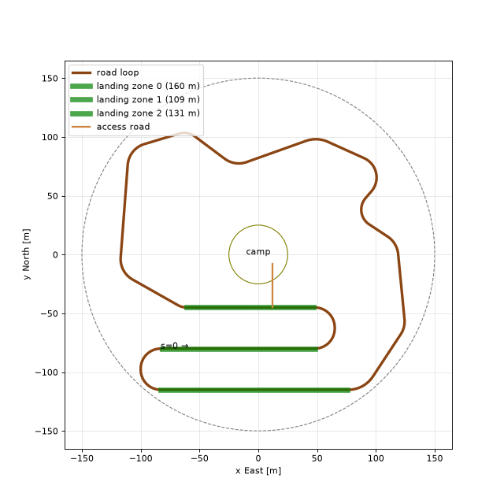
A 1.1 km forest loop
THE WORLD
3 landing zones
Straights with zero curvature: 160 m, 109 m and 131 m, marked with posts.
Hard parts on purpose
Two 180° hairpins, an S-curve and a tight 15 m crest curve.
One source of truth
The generator exports the centerline (s, x, y, heading, curvature, zone) for both agents.
Flatbed Falcon · 4
Notes:
~40 s. The world is generated by a script. It is a closed 1129 m road loop made of straights and circular arcs. The green segments are the three landing zones: straights with exactly zero curvature. We also added hard parts on purpose for path following: two hairpins, an S-curve and a tight 15 m curve. The generator writes the road centerline to a CSV with one point per meter, including curvature and which landing zone it is in. Both agents use that same file.

Slide 5
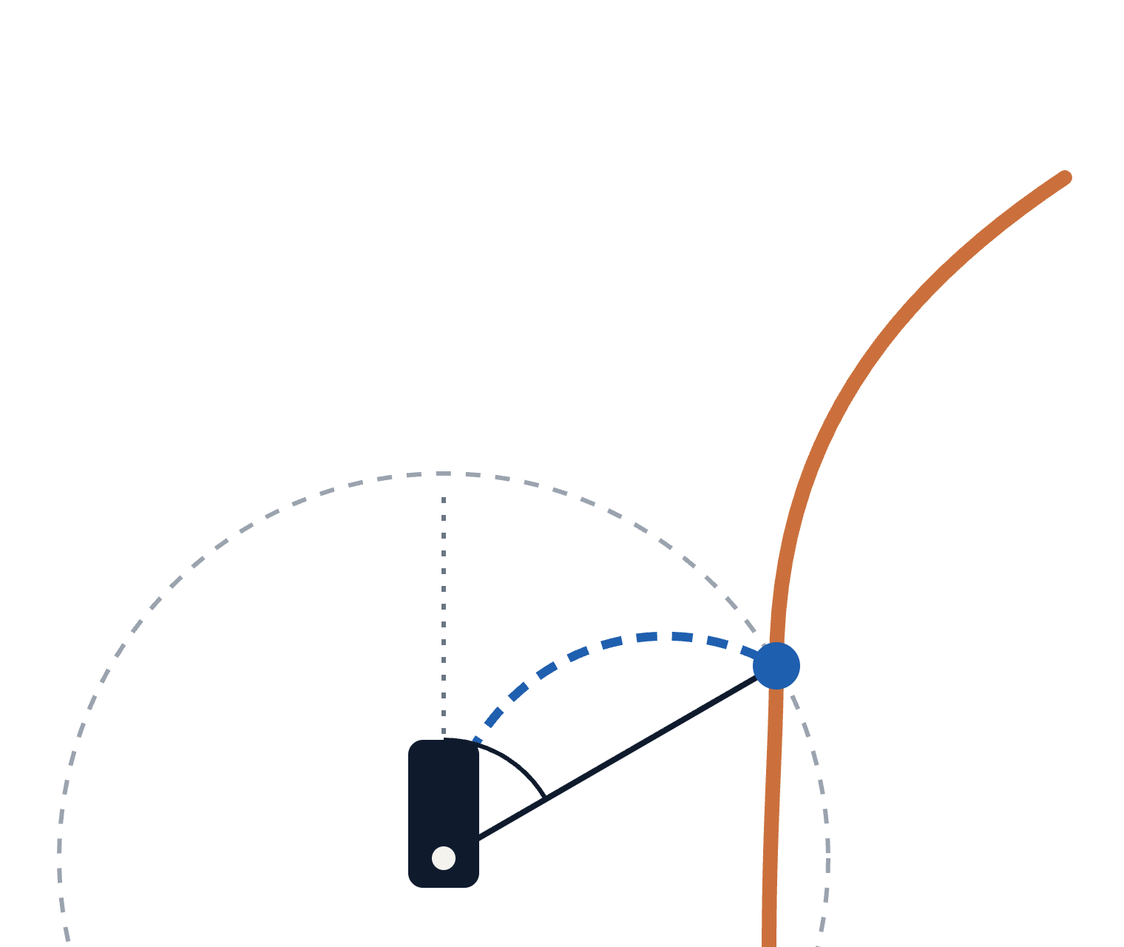
Pure Pursuit: chase a point on the road
TRUCK · LATERAL CONTROL
δ = atan(2L·sin α / l)
road
Steer along the arc that hits the pursuit point
l = 3 m + 0.8 s · v
Look further ahead at higher speed: smoother, less twitchy
pursuit point
α
ω = v · tan δ / L
l
The Ackermann plugin takes a yaw rate, not a steering angle
rear axle
Reused from Lab 3: SplinePath + PurePursuitController · L ≈ 3.0 m · 5
Notes:
~60 s. The truck follows the road with Pure Pursuit, which we reused from Lab 3. The idea: draw a circle with radius l around the rear axle, find where it crosses the road ahead, and steer along the circular arc that ends at that point. The steering angle comes from the angle alpha between the heading and the line to that point. We made the lookahead grow with speed, so at high speed the truck looks further ahead and does not oscillate, and at low speed it can still cut tight hairpins. One practical detail: Gazebo's Ackermann plugin wants a yaw rate, so we convert with omega = v tan(delta) / L. We also had to handle the wrap-around where the loop closes at s = 1129 m. [Result: lateral error X m on straights, Y m in hairpins.]

Slide 6
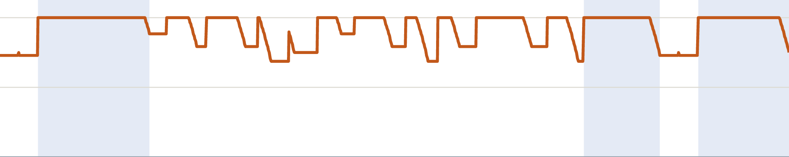
Slow down before the curves
TRUCK · SPEED CONTROL
v_ref(s) = min(v_max, √(a_lat / |κ(s)|))
8 m/s max · 2 m/s² lateral · PI speed loop
8 m/s
4 m/s
0
Landing zone 0
distance along the loop, 0 → 1129 m
Zone 1
Zone 2
Computed from road_centerline.csv · braking ramps at 1 m/s² · ≈ 2.6 min per lap · 6
Notes:
~40 s. Pure Pursuit only steers, so we also need a speed. We compute a reference speed from the road curvature: the speed where lateral acceleration stays under 2 m/s², capped at 8 m/s. This plot is that profile for our actual loop. It is 8 m/s on the straights and drops to about 5.5 m/s in the tightest 15 m curves. The ramps before each dip come from looking ahead: the truck starts braking before the curve instead of in it. The blue bands are the landing zones, all at full speed, so the drone has to land at up to 8 m/s. A PI controller tracks the reference.

Slide 7
Fly to where the bed will be
DRONE · TRACKING FLIGHT
Position
p̂_bed(t + τ) + (0, 0, −4 m)
KEY IDEA
Velocity
v_truck (feedforward)
Feedforward does the work. Feedback only fixes the small error left.
Yaw
truck heading
PX4 runs the inner position and velocity loops. We stream setpoints at 20 Hz in Offboard mode.
PD on relative error, then LQR on a double integrator (Lab 3)
Correction
Goal: < 0.3 m horizontal error on straights, 4 m above the bed · 7
Notes:
~60 s. Now the drone. After takeoff and approach, it enters TRACK. Each setpoint we send to PX4 has three parts. Position: the predicted bed position, a short time tau ahead to make up for the delay, plus 4 m up. Velocity: the truck's own velocity as feedforward. Yaw: the truck's heading. If you only use position feedback, the drone always lags behind a moving target. With the truck's velocity as feedforward, the drone already moves at the right speed, and the feedback loop only removes the small error that is left. We started with a PD loop on the relative error and then replaced it with LQR on a double-integrator model, using solve_discrete_are like in Lab 3. [Result: X m tracking error on straights.]

Slide 8



A state machine that knows when to give up
DRONE · LANDING
TAKEOFF
APPROACH
TRACK
DESCEND
TOUCHDOWN
LANDED
ABORT
left the cone, zone ending, or target lost → climb back to 4 m
Descent gate
Glide cone
Touchdown
Inside a landing zone with ≥ 15 s left, and error < 0.3 m, < 0.3 m/s for 1.5 s
Descend at 0.5 m/s. The allowed error shrinks as the drone gets lower
Own contact detection, then force-disarm. PX4's land detector fails on a moving bed
Flatbed Falcon · 8
Notes:
~60 s. Landing is a state machine. The drone only starts descending when three things hold: it is inside a landing zone, there is enough zone left for the whole descent, and the tracking error has been small for 1.5 seconds. During descent it stays inside a glide cone: the closer to the bed, the smaller the error we allow. If it leaves the cone, the zone runs out, or the target data goes stale, it aborts and climbs back to tracking height, then tries again on the next straight. For touchdown we could not use PX4's own land detector, because it assumes the ground is not moving. So we detect contact ourselves, with the bed's contact sensor, and force-disarm.

Slide 9
The truck helps, the filter fills the gaps
COOPERATION & ESTIMATION
Landing handshake
Kalman filter + prediction
Drone
READY_TO_LAND
We add Gaussian noise, latency and dropouts to the truck's pose, like a real radio link.
Truck
LANDING_OK
A constant-velocity / constant-turn filter smooths it, then predicts τ seconds ahead.
commits to constant speed to the end of the zone
Truck
The known road is the prior, so the prediction bends with the road instead of going straight.
Drone
LANDED / ABORT
Ideas from Lab 4 (cooperative agents) and Lab 5 (trajectory prediction) · 9
Notes:
~45 s. Two things make landing more robust. First, cooperation, from Lab 4: the drone asks to land, the truck answers OK when it enters a landing zone with enough room, and then it promises to hold a constant speed until the drone reports landed or aborted. That removes the hardest surprise: the truck braking mid-descent. Second, estimation, from Lab 5. Ground truth is too easy, so we add noise, delay and dropouts. A Kalman filter smooths the measurements and predicts where the bed will be a moment later. Because we know the road, the prediction follows the road. [Mention which of these you finished.]

Slide 10
Demo
WHAT TO WATCH FOR
1
The truck drives laps on its own
LIVE IN GAZEBO · ~3 MIN
2
The drone takes off, catches up and holds 4 m above the bed
3
Handshake in a landing zone, descent, touchdown
4
It stays on the bed through the next curves
Notes:
~3 min. Switch to the simulator. Narrate the four steps as they happen. Have a backup screen recording ready in case the sim is slow or the landing aborts; if it aborts live, that is fine, point out that ABORT works and it will retry on the next straight. Start the sim before the talk so Gazebo and PX4 are already up.

Slide 11
How well does it work?
RESULTS
[__] m
[__] m
[__] %
[__] cm
Truck lateral error, hairpins (goal < 1.0 m)
Drone tracking error, straights (goal < 0.3 m)
Landing success rate over [N] runs
Touchdown error from bed center
[Plot: success rate vs. truck speed 2–8 m/s, with and without noise/latency]
Seeded batch runs, logged to CSV by the logger node · 11
Notes:
~40 s. Fill in from the batch experiments. Lead with the success rate and how it changes with truck speed, since that is the most interesting result. Mention the number of aborts and that an abort followed by a successful retry still counts as a working system.

Slide 12
What we take with us
WRAP-UP
Feedforward first
NEXT STEPS
Knowing the truck's velocity mattered more than tuning gains.
Downward camera + AprilTag on the bed
Frames in one place
Latch the drone so it stays on in curves
ENU vs. NED and spawn offsets cause silent bugs. Keep them in one file.
Wind and rotor downwash
Cooperation is cheap safety
One promise from the truck, constant speed, makes the landing much easier.
Questions?
Flatbed Falcon · 12
Notes:
~30 s. Three takeaways. Edit these to match what actually surprised you during the project. Then next steps: a camera and marker on the bed instead of a radio link, a latch so the drone cannot slide off in curves, and disturbances like wind. Thank you, questions?

